Slide 1


Transport Layer
COMPSCI 453 Computer Networks
Professor Jim Kurose
College of Information and Computer Sciences
University of Massachusetts
Transport-layer services
Multiplexing and demultiplexing
Connectionless transport: UDP
Principles of reliable data transfer
Connection-oriented transport: TCP
Principles of congestion control
TCP congestion control
Evolution of transport-layer functionality
Class textbook:
Computer Networking: A Top-Down Approach (8th ed.)
J.F. Kurose, K.W. Ross
Pearson, 2020
http://gaia.cs.umass.edu/kurose_ross

Slide 2
TCP congestion control: AIMD
approach: senders can increase sending rate until packet loss (congestion) occurs, then decrease sending rate on loss event
Additive Increase
Multiplicative Decrease
increase sending rate by 1 maximum segment size every RTT until loss detected
cut sending rate in half at each loss event
AIMD sawtooth
behavior: probing
for bandwidth
TCP sender Sending rate
time

Slide 3
TCP AIMD: more
Multiplicative decrease detail: sending rate is
Cut in half on loss detected by triple duplicate ACK (TCP Reno)
Cut to 1 MSS (maximum segment size) when loss detected by timeout (TCP Tahoe)
Why AIMD?
AIMD – a distributed, asynchronous algorithm – has been shown to:
optimize congested flow rates network wide!
have desirable stability properties

Slide 4
TCP congestion control: details
sender sequence number space
TCP sending behavior:
roughly: send cwnd bytes, wait RTT for ACKS, then send more bytes
cwnd
last byte
ACKed
cwnd
sent, but not-yet ACKed
(“in-flight”)
available but not used
TCP rate
~
bytes/sec
~
RTT
last byte sent
TCP sender limits transmission:
cwnd is dynamically adjusted in response to observed network congestion (implementing TCP congestion control)
<
cwnd
LastByteSent- LastByteAcked

Slide 5

TCP slow start
Host A
Host B
when connection begins, increase rate exponentially until first loss event:
initially cwnd = 1 MSS
double cwnd every RTT
done by incrementing cwnd for every ACK received
one segment
RTT
two segments
four segments
summary: initial rate is slow, but ramps up exponentially fast
time

Slide 6
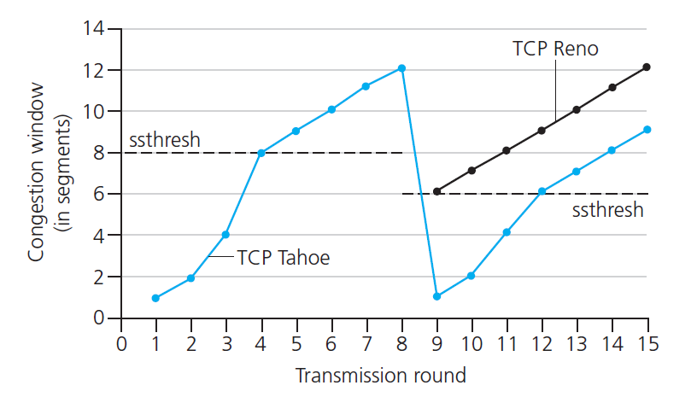

TCP: from slow start to congestion avoidance
Q: when should the exponential increase switch to linear?
A: when cwnd gets to 1/2 of its value before timeout.
X
Implementation:
variable ssthresh
on loss event, ssthresh is set to 1/2 of cwnd just before loss event
* Check out the online interactive exercises for more examples: http://gaia.cs.umass.edu/kurose_ross/interactive/

Slide 7


Summary: TCP congestion control
New
ACK!
New
ACK!
.
duplicate ACK
new ACK
dupACKcount++
new ACK
cwnd = cwnd + MSS (MSS/cwnd)
dupACKcount = 0
transmit new segment(s), as allowed
cwnd = cwnd+MSS
dupACKcount = 0
transmit new segment(s), as allowed
Λ
cwnd = 1 MSS
ssthresh = 64 KB
dupACKcount = 0
cwnd > ssthresh
slow
start
Λ
congestion
avoidance
timeout
ssthresh = cwnd/2
cwnd = 1 MSS
dupACKcount = 0
retransmit missing segment
duplicate ACK
timeout
dupACKcount++
ssthresh = cwnd/2
cwnd = 1 MSS
dupACKcount = 0
retransmit missing segment
timeout
New
ACK!
ssthresh = cwnd/2
cwnd = 1
dupACKcount = 0
retransmit missing segment
New ACK
dupACKcount == 3
cwnd = ssthresh
dupACKcount = 0
dupACKcount == 3
ssthresh= cwnd/2
cwnd = ssthresh + 3
retransmit missing segment
ssthresh= cwnd/2
cwnd = ssthresh + 3
retransmit missing segment
fast
recovery
duplicate ACK
cwnd = cwnd + MSS
transmit new segment(s), as allowed

Slide 8
TCP CUBIC
Is there a better way than AIMD to “probe” for usable bandwidth?
Insight/intuition:
W_{max}: sending rate at which congestion loss was detected
congestion state of bottleneck link probably (?) hasn’t changed much
after cutting rate/window in half on loss, initially ramp to to W_{max} faster, but then approach W_{max} more slowly
W_{max}
classic TCP
TCP CUBIC - higher throughput in this example
W_{max}/2

Slide 9
TCP CUBIC
K: point in time when TCP window size will reach W_{max}
K itself is tuneable
increase W as a function of the cube of the distance between current time and K
larger increases when further away from K
smaller increases (cautious) when nearer K
TCP CUBIC default in Linux, most popular TCP for popular Web servers
W_{max}
TCP Reno
TCP CUBIC
TCP
sending
rate
time
t₀
t₁
t₂
t₃
t₄

Slide 10
TCP and the congested “bottleneck link”
TCP (classic, CUBIC) increase TCP’s sending rate until packet loss occurs at some router’s output: the bottleneck link
source
destination
application
TCP
network
link
physical
application
TCP
network
link
physical
packet queue almost never empty, sometimes overflows packet (loss)
bottleneck link (almost always busy)

Slide 11
TCP and the congested “bottleneck link”
TCP (classic, CUBIC) increase TCP’s sending rate until packet loss occurs at some router’s output: the bottleneck link
understanding congestion: useful to focus on congested bottleneck link
insight: increasing TCP sending rate will not increase end-end throughout with congested bottleneck
source
destination
application
TCP
network
link
physical
application
TCP
network
link
physical
insight: increasing TCP sending rate will increase measured RTT
Goal: “keep the end-end pipe just full, but not fuller”
RTT

Slide 12
Delay-based TCP congestion control
Keeping sender-to-receiver pipe “just full enough, but no fuller”: keep bottleneck link busy transmitting, but avoid high delays/buffering
# bytes sent in last RTT interval
RTT_{measured}
measured
throughput
=
RTT_{measured}
Delay-based approach:
RTT_{min} - minimum observed RTT (uncongested path)
uncongested throughput with congestion window cwnd is cwnd/RTT_{min}
if measured throughput “very close” to uncongested throughput
increase cwnd linearly /* since path not congested */
else if measured throughput “far below” uncongested throughout
decrease cwnd linearly /* since path is congested */

Slide 13
Delay-based TCP congestion control
congestion control without inducing/forcing loss
maximizing throughout (“keeping the just pipe full… ”) while keeping delay low (“…but not fuller”)
a number of deployed TCPs take a delay-based approach
BBR deployed on Google’s (internal) backbone network

Slide 14
Explicit congestion notification (ECN)
TCP deployments often implement network-assisted congestion control:
two bits in IP header (ToS field) marked by network router to indicate congestion
policy to determine marking chosen by network operator
congestion indication carried to destination
destination sets ECE bit on ACK segment to notify sender of congestion
involves both IP (IP header ECN bit marking) and TCP (TCP header C,E bit marking)
source
TCP ACK segment
destination
application
TCP
network
link
physical
application
TCP
network
link
physical
ECE=1
ECN=10
ECN=11
IP datagram

Slide 15
TCP fairness
Fairness goal: if K TCP sessions share same bottleneck link of bandwidth R, each should have average rate of R/K
TCP connection 1
bottleneck
router
capacity R
TCP connection 2

Slide 16
Q: is TCP Fair?
Example: two competing TCP sessions:
additive increase gives slope of 1, as throughout increases
multiplicative decrease decreases throughput proportionally
R
equal bandwidth share
Is TCP fair?
A: Yes, under idealized assumptions:
same RTT
fixed number of sessions only in congestion avoidance
loss: decrease window by factor of 2
congestion avoidance: additive increase
Connection 2 throughput
loss: decrease window by factor of 2
congestion avoidance: additive increase
Connection 1 throughput
R

Slide 17
Fairness: must all network apps be “fair”?
Fairness and UDP
multimedia apps often do not use TCP
do not want rate throttled by congestion control
instead use UDP:
send audio/video at constant rate, tolerate packet loss
there is no “Internet police” policing use of congestion control
Fairness, parallel TCP connections
application can open multiple parallel connections between two hosts
web browsers do this , e.g., link of rate R with 9 existing connections:
new app asks for 1 TCP, gets rate R/10
new app asks for 11 TCPs, gets R/2

Slide 18

Transport Layer
COMPSCI 453 Computer Networks
Professor Jim Kurose
College of Information and Computer Sciences
University of Massachusetts
Transport-layer services
Multiplexing and demultiplexing
Connectionless transport: UDP
Principles of reliable data transfer
Connection-oriented transport: TCP
Principles of congestion control
TCP congestion control
Evolution of transport-layer functionality
Class textbook:
Computer Networking: A Top-Down Approach (8th ed.)
J.F. Kurose, K.W. Ross
Pearson, 2020
http://gaia.cs.umass.edu/kurose_ross
Video: 2020, J.F. Kurose, All Rights Reserved
Powerpoint: 1996-2020, J.F. Kurose, K.W. Ross, All Rights Reserved

Slide 19
Backup slides

Slide 20
TCP throughput
avg. TCP thruput as function of window size, RTT?
ignore slow start, assume there is always data to send
W: window size (measured in bytes) where loss occurs
avg. window size (# in-flight bytes) is ¾ W
avg. thruput is 3/4W per RTT
avg TCP thruput =
3
W
4
RTT
bytes/sec
W
W/2

Slide 21
TCP Congestion Control
“Classic” TCP: loss-based, end-end
additive increase, multiplicative decrease
“slow” start
CUBIC
Enhanced TCPs:
delay-based congestion control TCP
explicit congestion notification
TCP fairness

